Slide 1
FitDay
Healthy day to you
DATA REVOLVERS
SUMIT DESHMUKH, MAANSI CHANDIRA, LEANDRA MENEZES, VIPRA SHAH
TA: ABHIJEET PATIL

Slide 2
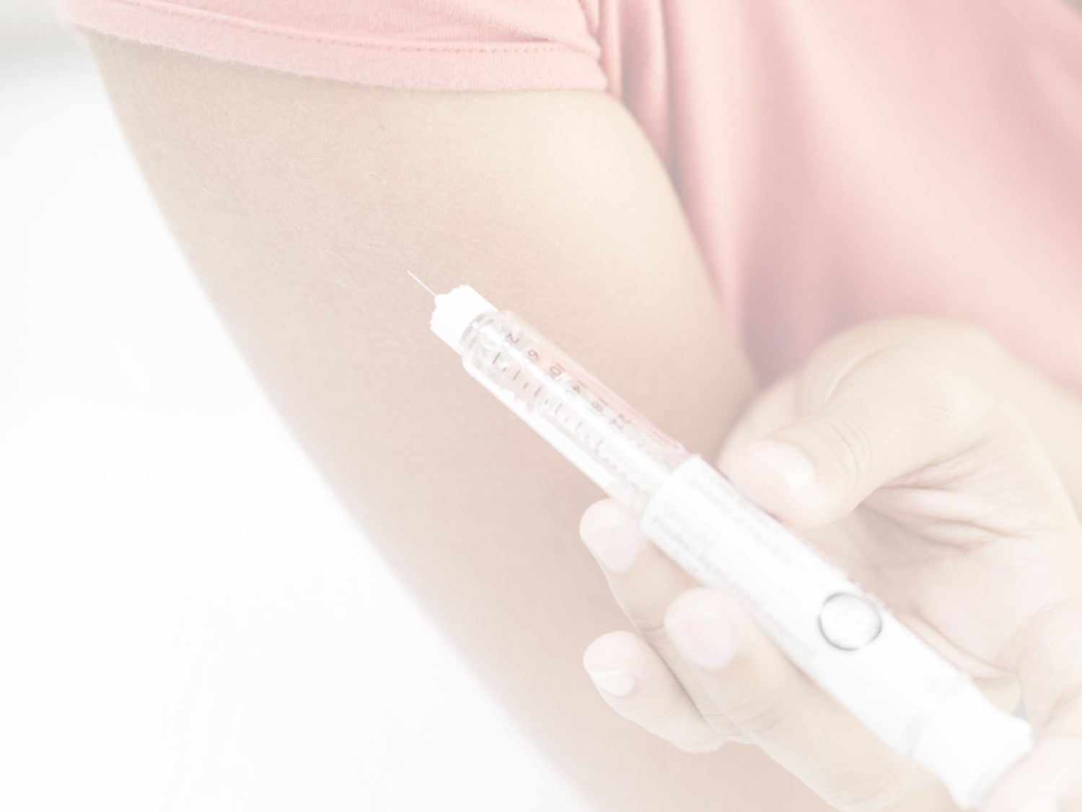
Diabetes – Now and Future
Over 21 million people of the population are suffering from diabetes in USA alone.
More than 8 million people have diabetes, yet unaware about it.
Common symptoms of diabetes: Cuts/bruises that are slow to heal, Feeling very hungry - even though you are eating.
Current diagnosing technique involves invasive blood tests such as
1) Random blood sugar test
2) Fasting blood sugar test.
Necessity of noninvasive technique to continuously monitor glucose is the need of the hour.
FitDay foresees that fitness tracker devices will include biosensors to monitor a Diabetic patient in the near future.
Having glucose information as easy as heart rate or calories burned will be vital to live a healthy life.
Notes:
http://www.cdc.gov/diabetes/data/statistics/2014statisticsreport.html,
http://www.diabetes.org/diabetes-basics/symptoms/#sthash.EySKLFDm.dpuf

Slide 3
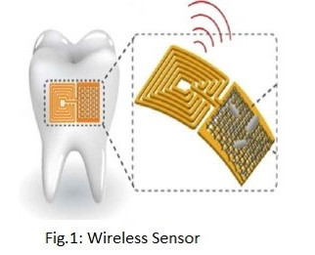
Why this topic?
Evolution of bio - chemical sensors has made it possible to measure glucose level from Saliva.
These sensors have wireless modules that can send data to connected device.
Data from device can be monitored and analyzed to suggest appropriate treatment and remedies.

Slide 4
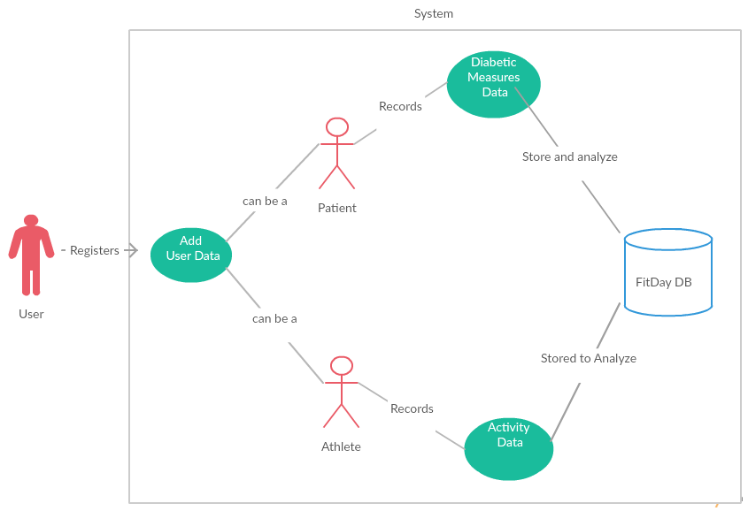
FitDay User Roles
User registers himself in the FitDay system as Athlete and/or Patient.
The system stores diabetic measures or activity data from user’s device.
Analysis of User Data is done and appropriate suggestions are made.

Slide 5
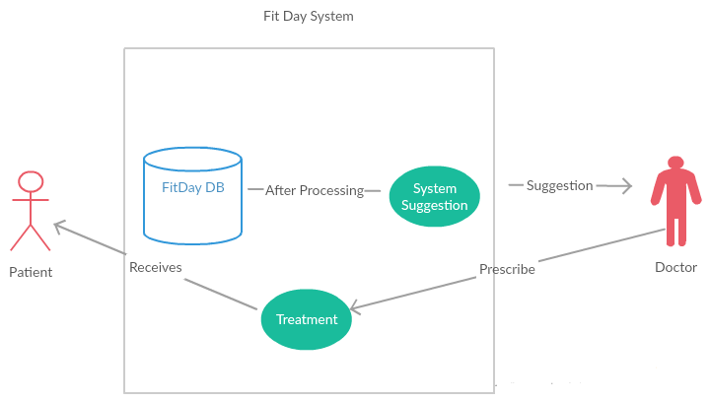
Doctor Patient Use Case
FitDay system after processing diabetic measures of each patient provides suggestion to doctor
Doctor refers to the system suggestion and prescribes treatment to the patient

Slide 6
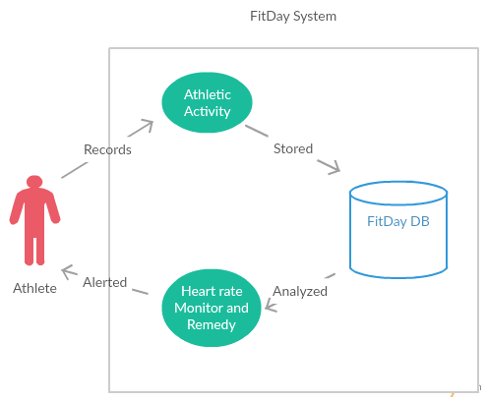
Athlete Use Case
Athlete activity and vital signs are recorded in the system and stored in the FitDay database for analysis.
The system analyzes heart rate and suggests remedies to the athlete
Calories burned during the activities are also stored for each athlete

Slide 7
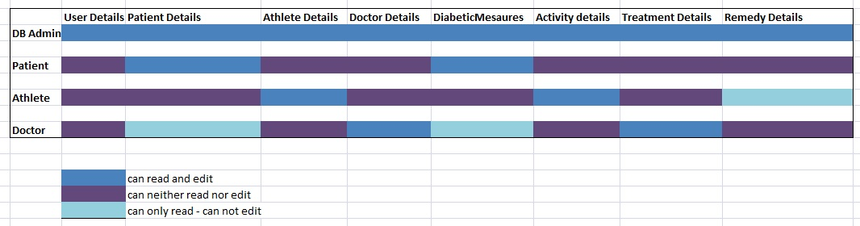
Users And Privileges

Slide 8
Normalization
Normalized databases fair very well under conditions where the applications are write-intensive and the write-load is more than the read-load.
Main cause of concern with fully normalized tables is that normalized data means joins between tables.
Joining means that read operations have to suffer because indexing strategies do not go well with table joins.

Slide 9
De-normalization
Denormalized databases fair well under heavy read-load and when the application is read intensive.
The data is present in the same table so there is no need for any joins, hence the selects are very fast.
A single table with all the required data allows much more efficient index usage.
Selects can be very fast on denormalized tables, but because the data is duplicated, the updates and inserts become complex and costly
Denormalized schema greatly improves performance with efficient use of triggers.

Slide 10
Which approach is better?
Neither of the approach can be entirely neglected, because a real world application is going to have both read-loads and write-loads.
Hence the correct way would be to utilize both the normalized and denormalized approaches depending on situations.

Slide 11
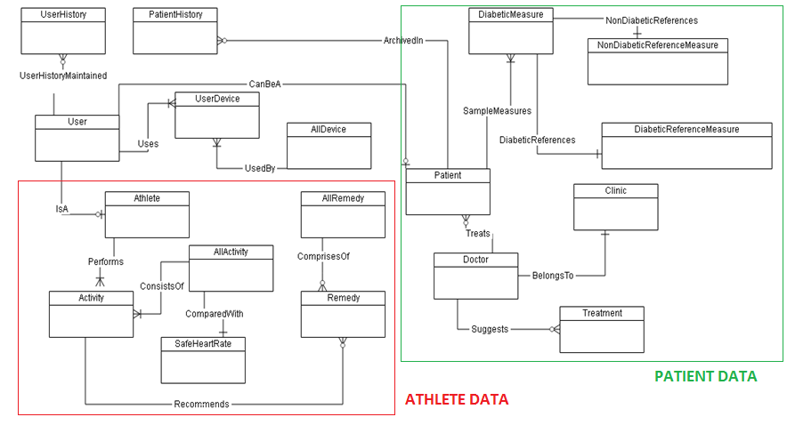
Entity Relationship Diagram

Slide 12
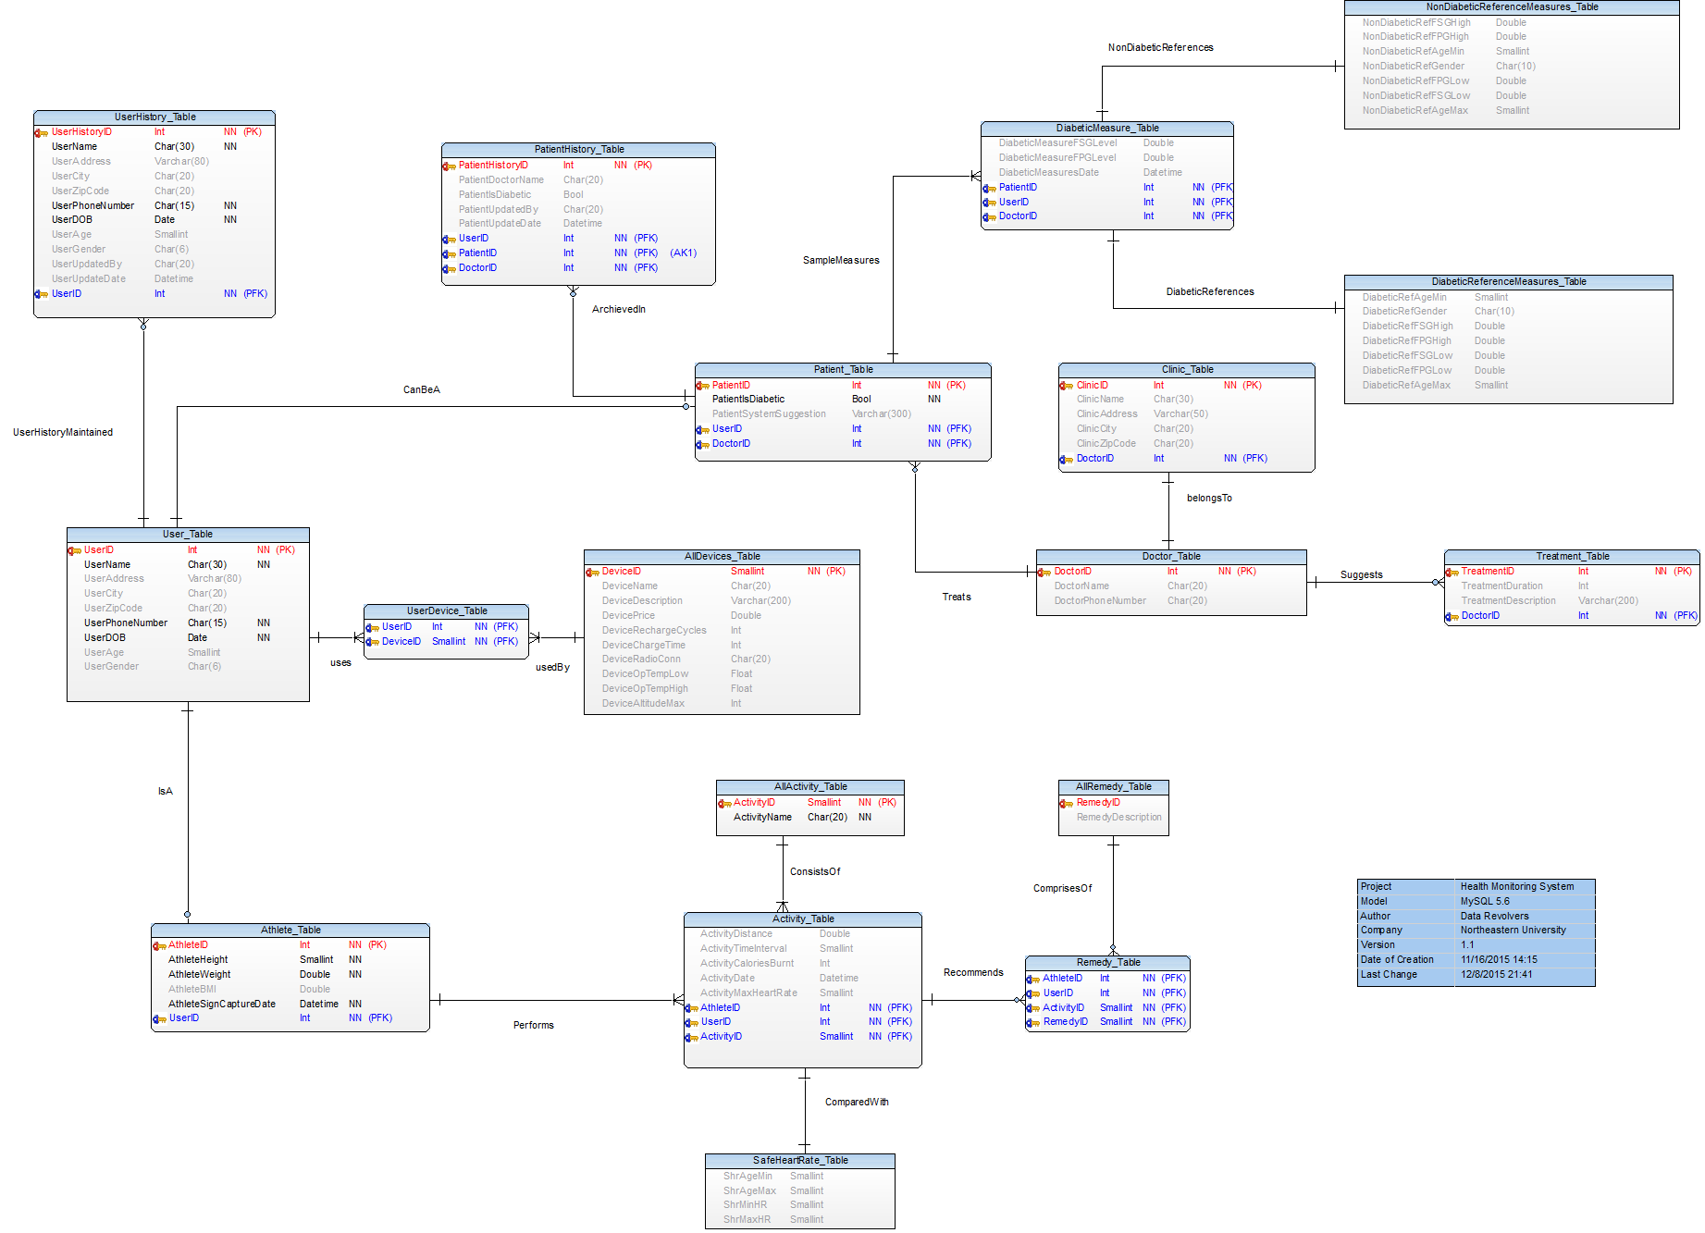
Enhanced Entity- Relationship Diagram

Slide 13

Assumptions
Data isn’t 100% factual – interpolated and extrapolated with existing data.
Patients have already been diagnosed with diabetes and doctor is monitoring patient through FitDay system.
Continuous diabetic measures are being collected from patients and fed into the FitDay system.
FitDay system gives suggestion to doctors and doctor prescribes appropriate treatment accordingly.
Athletes are recording their activity details in the FitDay system.

Slide 14
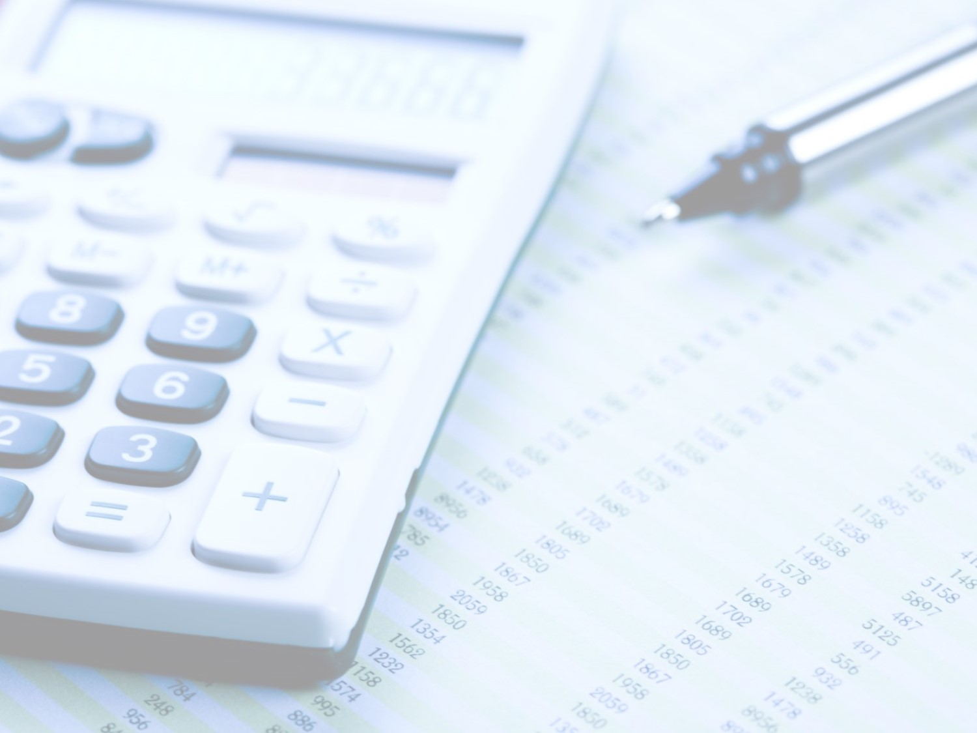
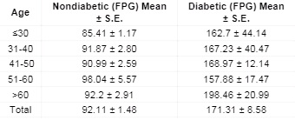
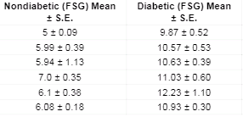
Calculations
For running activity on flat surface: CB = [0.0215 x KPH³ - 0.1765 x KPH² + 0.8710 x KPH + 1.4577] x WKG x T
    CB = Calorie burn (in calories)
    KPH = Running speed (in kilometers per hour)
    WKG = Weight (in kilograms)
    T = Time (in hours)
For Diabetic patients:

Slide 15
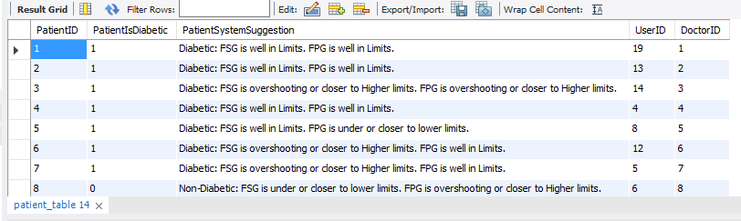
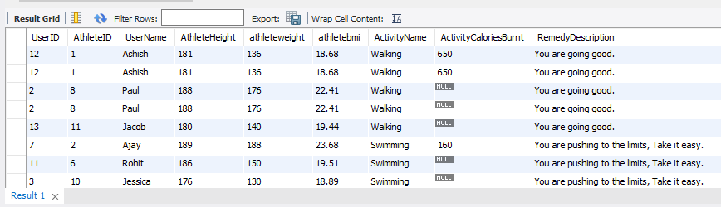
Results
For Diabetic patient:
For Athlete:

Slide 16
Demo

Slide 17
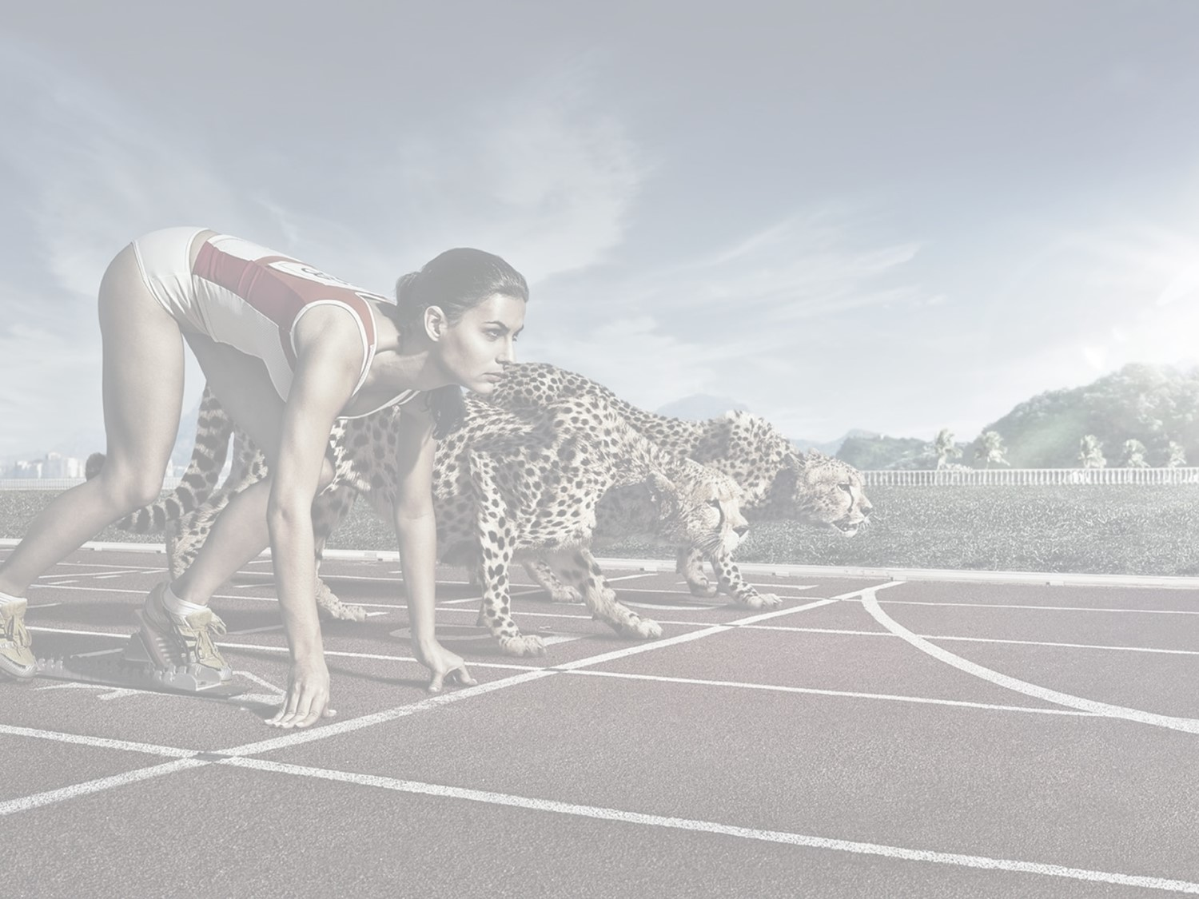
Benefits
Non Invasive technique of diagnosis
Continuous monitoring of diabetic measures for patient and heart rate for athletes
Helps the patient to track their diabetic measures
Helps athletes to track their workout and burnt calories
Prevents fatalities due to excessive workouts trainings
Instant remedies and suggestions are provided
Helps BA analyze the data and suggest solutions

Slide 18

Tools Used
MySQL Workbench 6.3.5
TOAD Data Modeler 5.5

Slide 19
References
Noninvasive Method for Glucose Level Estimation by Saliva
Agrawal RP1*, Sharma N2, Rathore MS2, Gupta VB2, Jain S1, Agarwal V1 and Goyal S1
2014 diabetes statistics report-CDC
Diabetes.org journal
Walking Calorie Burn Formula
Glucose levels in normal people and in diabetic patients
D. K. Sen And G. S. Sarin

Slide 20
Acknowledgements
Prof. Chaiyaporn Mutsalklisana
TA: Abhijeet Patil

